Slide 1
Galaxy Update
Neil Wang
2014-07-14

Slide 2
Agenda
Project introduction
Architecture
User scenarios
Demo
Next step
Q&A

Slide 3

Project Introduction
Galaxy
Galaxy (UI)
Force
(Light) Saber

Slide 4
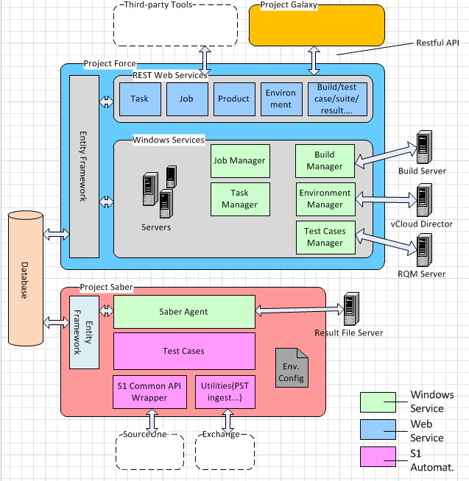
Architecture

Slide 5
Done before last update
The first update
The draft UI
The Environment/Task/Job management
The second update
The S1 common library wrapper

Slide 6
What we’ve done last three months
Refine UI
S1 installation
Integrate the Galaxy/Force and Saber for S1
Build management
Integration of RQM for test case sync/filtering
Dispose the environment
Code refactoring and Stabilization

Slide 7
Write Manual/Automation Test
Write Test Cases on RQM
Set Module, Ranking, Feature…
Create Test Suite to specify dependency
Get the WebId from RQM
Write script with Saber C#
Add the WebId as property on test
Submit script to CC
Notes:
Manual Test:
Write test cases in RQM, specifying the rank/module->feature/release
Create the test suite to specify the dependency of the test cases(whether they can be executed on the same environment)
Automation Test:
Create the automation scripts
Pick the manual test cases in RQM to be automated
Automated the test cases using Saber
Mark the test case as automated in RQM
Add the WebId property into the Code
Submit the automation test cases into CC/TFS

Slide 8
Run Automation
Run Automation Testing:
Set general information
Create automation task
Set schedule for task
Select build and environment
Select test cases/suites (Filtering)
Task complete, triage results
Insert build record after build finished
Create a task using Restful API
Else, build is not valid
Smoke test pass, build valid
Triage
Integrate with build process:
Notes:
Run automation on demand/schedule
Input the general information about the task
Specify the schedule information
Specify the build and test environment
Filter and select the test cases/suites to run
Create the task and wait the complement of the task
Triage the test result
Integrate QA automation with the Build process
Build engineer start a build
Insert the build information into Force by script
Submit a task to run the smoke test on the build
If smoke test passed, QA can take this build for testing
Else, triage the result and mark the build as invalid if necessary

Slide 9
Administrator
Environment Management
Test Suite Management
User Management
Create template in vCloud
Create and maintain test suites(Smoke, Sanity …)
Add environment record in Galaxy
Add the mapping between environment and product
Create user
Delete user
…
Notes:
System Administration
Admin create the vCloud template containing the necessary information needed
Admin insert a test environment into the system with the configuration of the test environment
Other QA can submit the task on this new environment

Slide 10
Demo

Slide 11
Next Step
Leverage the output of S1 installation project
Support the test agent running on Linux
Support the automation testing in Ruby/Java
Help team to write automation based on common library and integrate them into Galaxy
Other features needed
Fast!!!

Slide 12
Q&A

